Slide 1
CENG401 MACHINE LEARNING AND ARTIFICIAL INTELLIGENCE
WEEK-4
Asst.Prof.Dr. Murat ŞİMŞEK

Slide 2

Informed (Heuristic) Search
Notes:
Intelligent agents are supposed to maximize their performance measure.

Slide 3
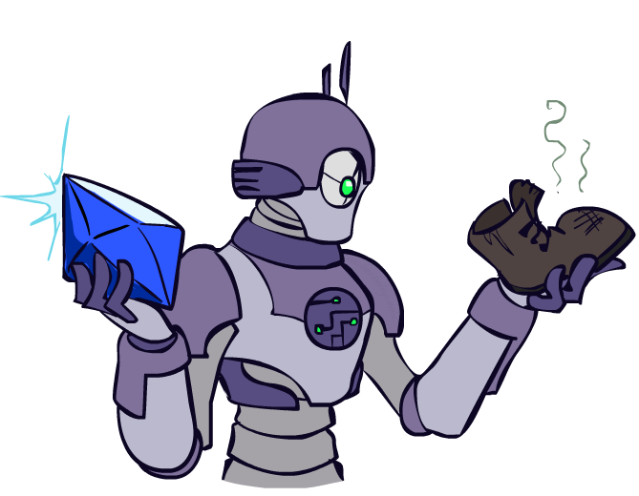
Today
Informed Search
Heuristics
Greedy Search
A* Search
Graph Search

Slide 4

Video of Demo Contours UCS Pacman Small Maze

Slide 5
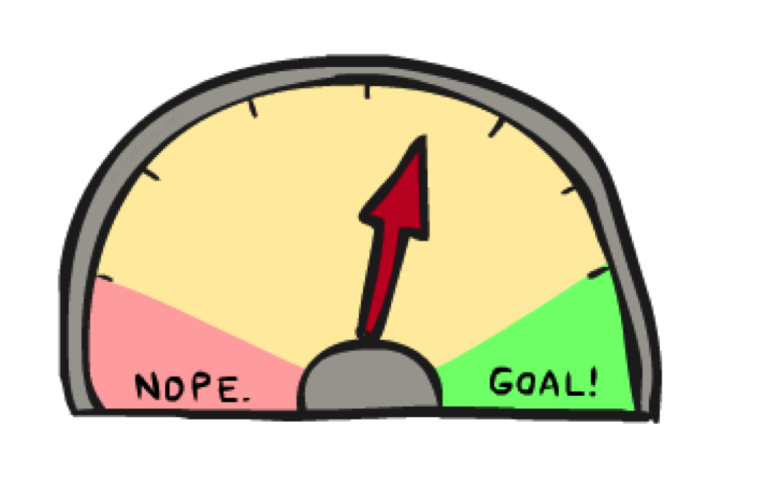
Informed Search

Slide 6
Heuristic Search
Heuristic - a “rule of thumb” used to help guide search
often, something learned experientially and recalled when needed
Heuristic Function - function applied to a state in a search space to indicate a likelihood of success if that state is selected
heuristic search methods are known as “weak methods” because of their generality and because they do not apply a great deal of knowledge
the methods themselves are not domain or problem specific, only the heuristic function is problem specific
Heuristic Search –
given a search space, a current state and a goal state
generate all successor states and evaluate each with our heuristic function
select the move that yields the best heuristic value

Slide 7



Search Heuristics
A heuristic is:
A function that estimates how close a state is to a goal
Designed for a particular search problem
Examples: Manhattan distance, Euclidean distance for pathing
10
5
11.2

Slide 8

Greedy Search

Slide 9
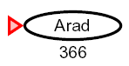
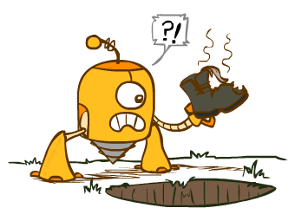
Greedy Search
Expand the node that seems closest…

Slide 10
Greedy Search
b
Strategy: expand a node that you think is closest to a goal state
Heuristic: estimate of distance to nearest goal for each state
A common case:
Best-first takes you straight to the (wrong) goal
Worst-case: like a badly-guided DFS
…
b
…
Notes:
For any search problem, you know the goal. Now, you have an idea of how far away you are from the goal.

Slide 11
Video of Demo Contours Greedy (Empty)

Slide 12
Video of Demo Contours Greedy (Pacman Small Maze)

Slide 13
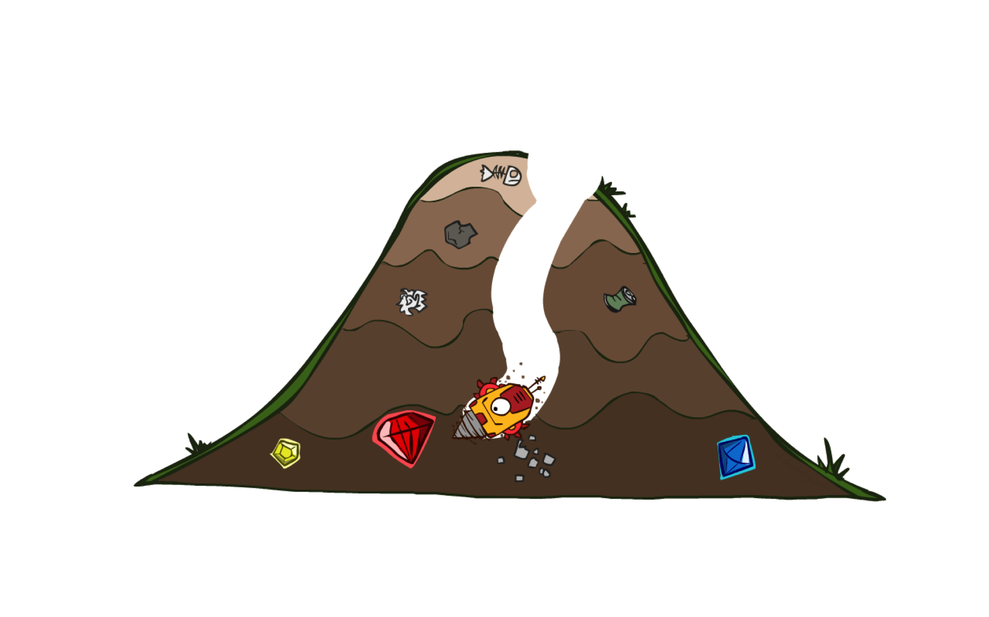
A* Search

Slide 14
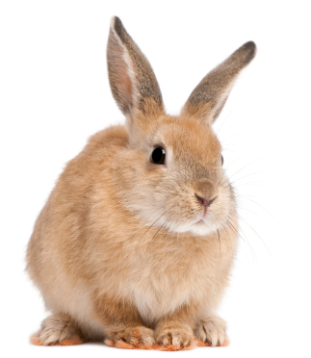
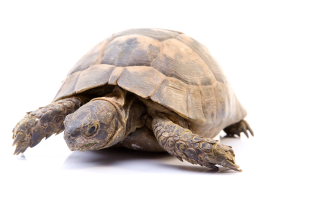
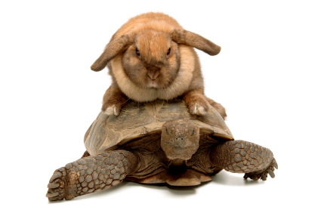
A* Search
UCS
Greedy
A*
Notes:
A* (pronounced "A-star") is a graph traversal and path search algorithm, which is used in many fields of computer science due to its completeness, optimality, and optimal efficiency.^{[1]} One major practical drawback is its {\displaystyle O(b^{d})} space complexity, as it stores all generated nodes in memory. Thus, in practical travel-routing systems, it is generally outperformed by algorithms which can pre-process the graph to attain better performance,^{[2]} as well as memory-bounded approaches; however, A* is still the best solution in many cases.^{[3]}

Slide 15
A* Search Algorithm Definition
A* (pronounced "A-star") is a graph traversal and path search algorithm, which is used in many fields of computer science due to its completeness, optimality, and optimal efficiency.
One major practical drawback is its space complexity, as it stores all generated nodes in memory.
Thus, in practical travel-routing systems, it is generally outperformed by algorithms which can pre-process the graph to attain better performance as well as memory-bounded approaches; however, A* is still the best solution in many cases.

Slide 16
Combining UCS and Greedy
Uniform-cost orders by path cost, or backward cost g(n)
Greedy orders by goal proximity, or forward cost h(n)
A* Search orders by the sum: f(n) = g(n) + h(n)
8
g = 0 h=6
S
e
h=1
g = 1 h=5
a
1
1
3
2
g = 2 h=6
g = 9 h=1
S
a
d
G
b
d
g = 4 h=2
e
h=6
1
h=5
h=2
h=0
1
g = 3 h=7
g = 6 h=0
g = 10 h=2
c
b
c
G
d
h=7
h=6
g = 12 h=0
G

Slide 17
Properties of A*

Slide 18
Properties of A*
Uniform-Cost
A*
b
b
…
…

Slide 19
UCS vs A* Contours
Uniform-cost expands equally in all “directions”
A* expands mainly toward the goal, but does hedge its bets to ensure optimality
Start
Goal
Start
Goal

Slide 20

A*: Summary

Slide 21
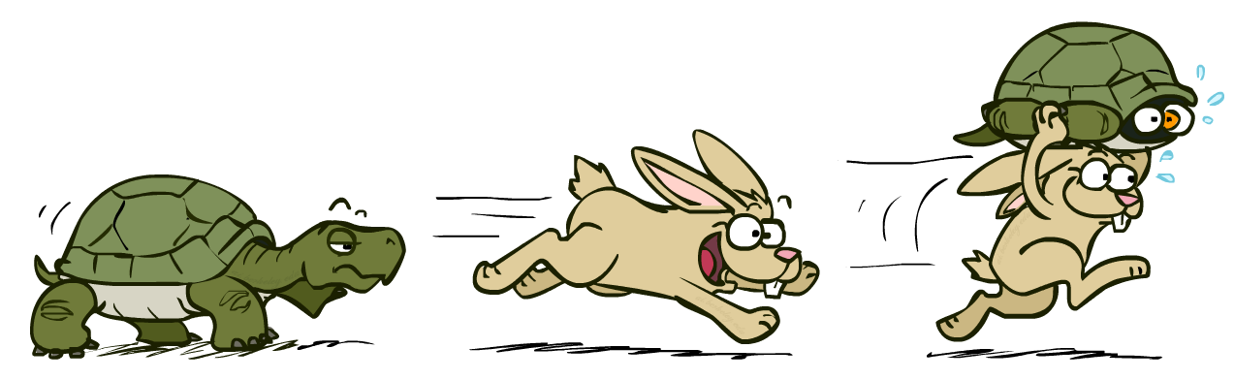
A*: Summary
A* uses both backward costs and (estimates of) forward costs
A* is optimal with admissible / consistent heuristics
Heuristic design is key: often use relaxed problems

Slide 22
Video of Demo Contours (Empty) -- UCS

Slide 23
Video of Demo Contours (Empty) -- Greedy

Slide 24
Video of Demo Contours (Empty) – A*

Slide 25
Video of Demo Contours (Pacman Small Maze) – A*

Slide 26



Comparison
Greedy
Uniform Cost
A*

Slide 27
End of the Week…

